Slide 1
Crime Data Analysis of a Los Angeles of year 2023
Areena Syed
Varshith Reddy
Dinesh Chandra Gaddam
Long Huynh

Slide 2
Background
Public Safety Concerns
- Ensuring the safety and security of residents
Uncovering Insights through Analysis
- Analyzing crime data allows for the extraction of valuable insights
Factors Influencing Crime Rates
- Crime rates can be influenced by a multitude of factors

Slide 3
Table of Contents
01
02
03
Data Background
Data Cleaning
About the Data.
Data Balancing.
Exploratory Data Analysis
Feature Engineering. Data Interpretation.
04
05
Prediction Model
Conclusion
Logit Regression. Confusion Matrix. Random Forest Classifier etc.
Model Summary.

Slide 4
Data Preprocessing

Slide 5
About the Data
What – ​Los Angeles Crime Data from Data Governance
​
How Many – 925K+ observations & 28 features
​
When – 2023 Year’s data
Why – To address Crime issues and ensure community well-being
Notes:
Machine Learning Repository of University of California at Irvine provides a dataset with a heterogeneous set of features about articles published by Mashable, a popular blogs site in the world, during a period of two years. A copy of this dataset is taken from Kaggle instead, due to difficulties in downloading from the original source. This dataset consists of 39,664 observations for 61 different variables, with the number of shares as our dependent variable.
There are two main popularity prediction approaches: those that use features only known after publication and those that do not use such features. The dataset that we have used consists of features that are known before publication. Though the prediction performance is usually low in the latter case, it is of more value addition to authors and content creators.

Slide 6

Data Cleaning
Handled Missing Values
Removed Unnecessary Columns
Converted Data Types
Filtered Data

Slide 7
Understanding the Data
Unnecessary columns are removed.
Data entries with invalid or missing victim ages are filtered out.
Date columns are converted to datetime format.
Only data for the year 2023 is selected.
Missing values are handled
Notes:
Extracted features like- keywords, digital media content(e.g., images, video), earlier popularity of news referenced in the article, earlier popularity of news referenced in the article; average number of shares of keywords prior to publication; and natural language features like sentiment polarity and latent dirichlet allocation.
We didn’t deep dive into these NLP features too much but understood the overall gist.
The Latent Dirichlet Allocation (LDA) algorithm was applied to all Mashable articles in order to first identify the five top relevant topics and then measure the closeness of current article to such topics. To compute the subjectivity and polarity sentiment analysis, pattern web mining module was used. Subjectivity measures how subjective the article is – in terms of personal opinions vs facts. It ranges from 0-1 with a higher score indicating more personal opinions and lower indicating factual inclination. Polarity sentiment analysis indicates the sentiment – negative, neutral and positive. It ranges from –1 to 1.
Some of the attributes in the dataset have already been encoded for machine learning. However, we will decode it into a single column for visualization purposes. Like data_channel and publish_day. Data_channel are technology, business, world, etertainment etc.
Some of the features are dependent of particularities of the Mashable service (whose articles have been used as data source): articles often reference other articles published in the same service; and articles have meta-data, such as keywords, data channel type and total number of shares (when considering Facebook, Twitter, Google+, LinkedIn, Stumble-Upon and Pinterest). The minimum, average and maximum number of shares was determined of all Mashable links cited in the article were extracted to prepare the data. Similarly, rank of all article keyword average shares was determined, in order to get the worst, average and best keywords. For each of these keywords, the minimum, average and maximum number of shares was extracted as a feature.
Interesting point raised by Prof Lo in project proposal feedback. Number of shares can be dependent on the time after publish so is it a moving target? After researching for this online, we found studies that indicate a convergence is reached 3 weeks after publishing. So we flitered our data on timedelta, to include only articles that were > 21. To reinforce this point – we wanted to see if there was any relationship between number of shares and increasing time delta.

Slide 8
Exploratory
Data Analysis

Slide 9
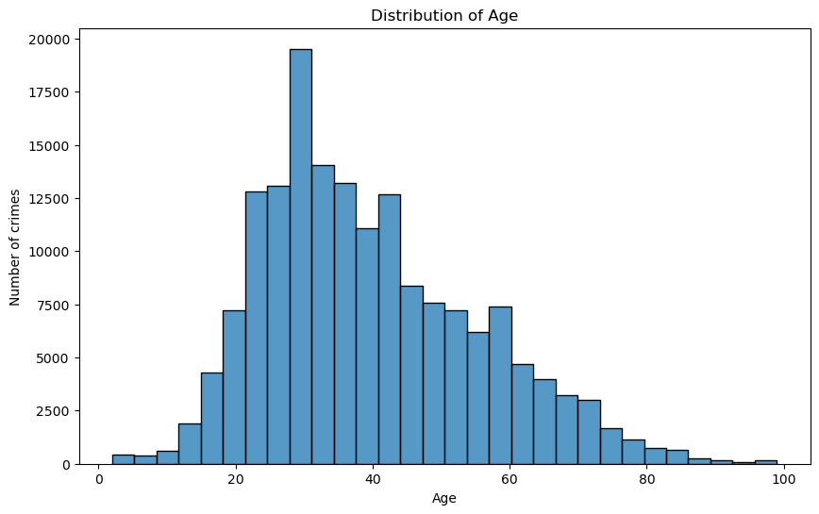
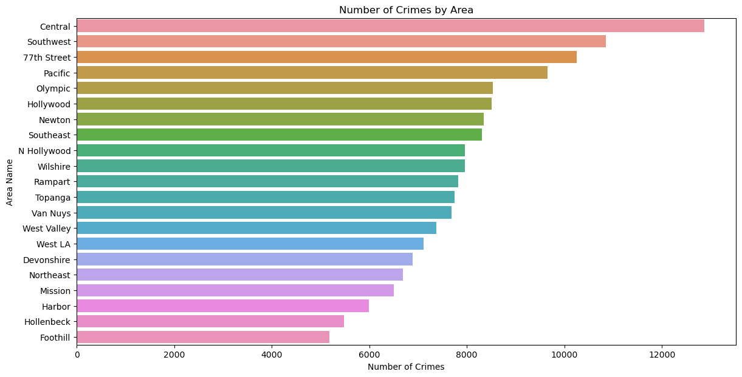
Victim age vs Crime Count
Area vs Crime Count

Slide 10
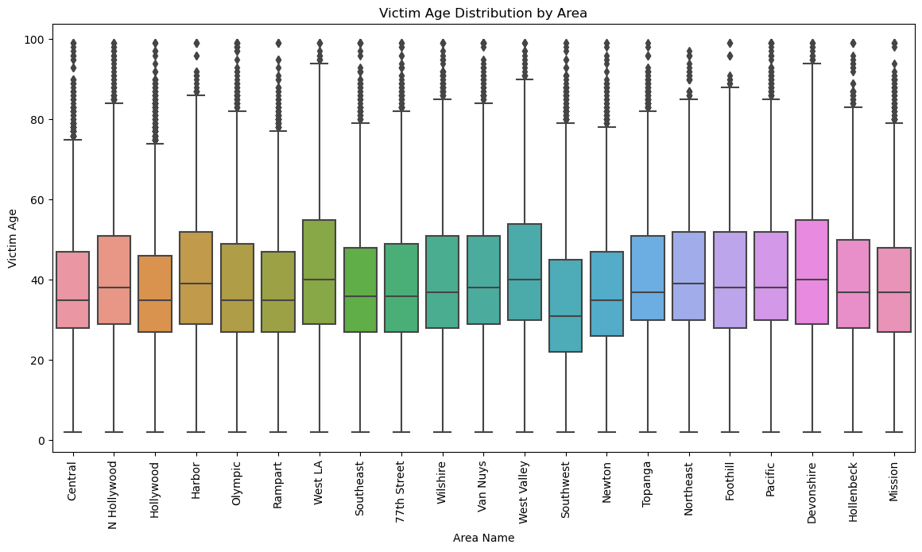

Slide 11
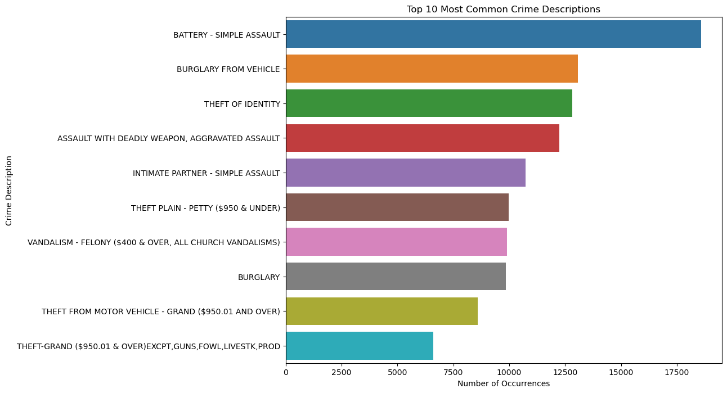

Slide 12
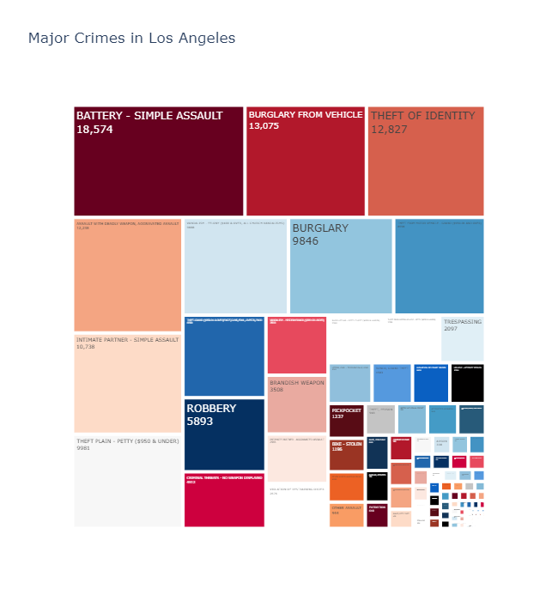

Slide 13
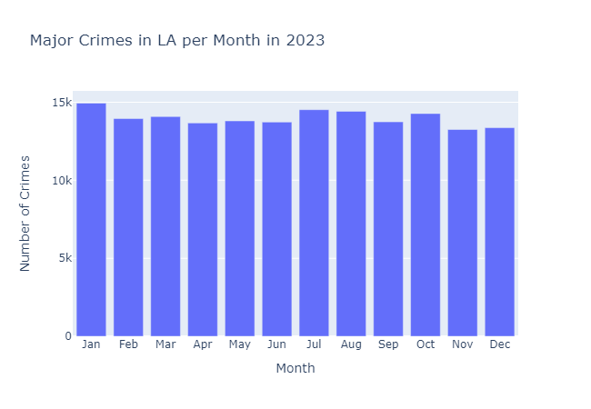
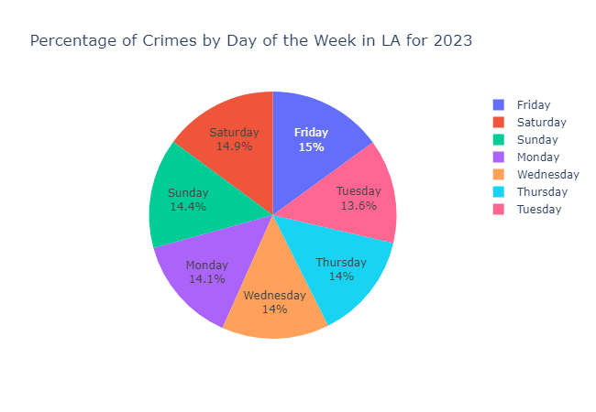

Slide 14
Smart Questions

Slide 15
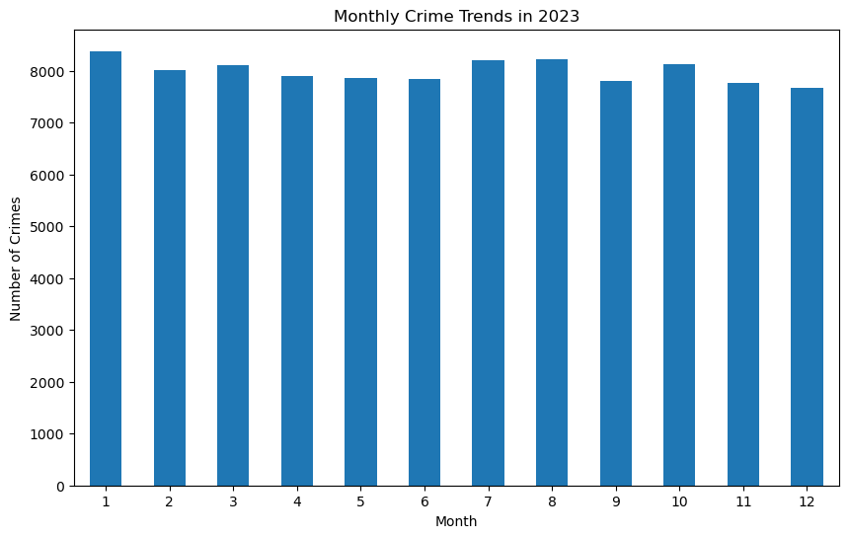
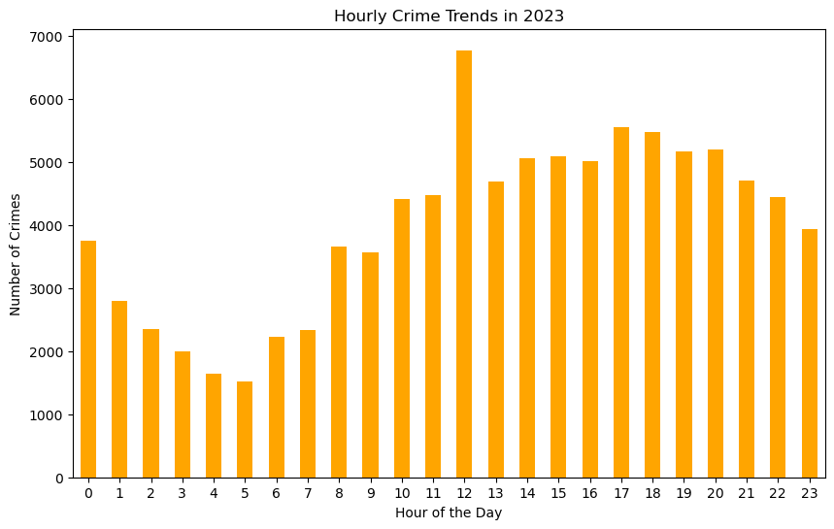
SMART Q1: Can we identify emerging spatial and temporal patterns or hotspots for crime categories to inform proactive and targeted interventions?

Slide 16
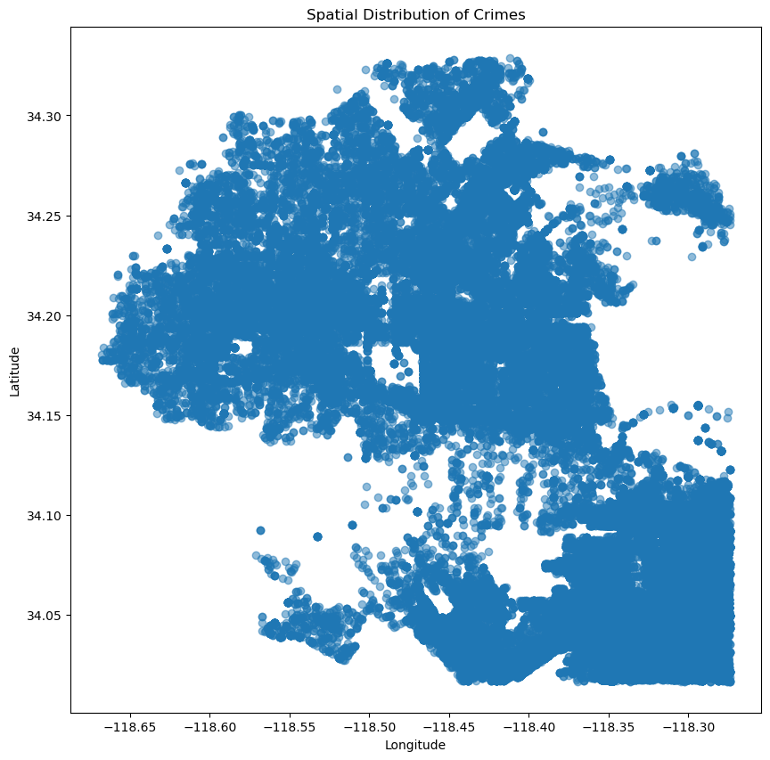
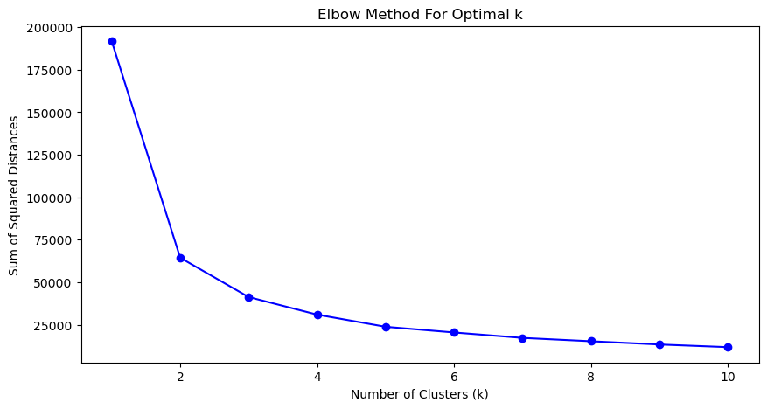

Slide 17
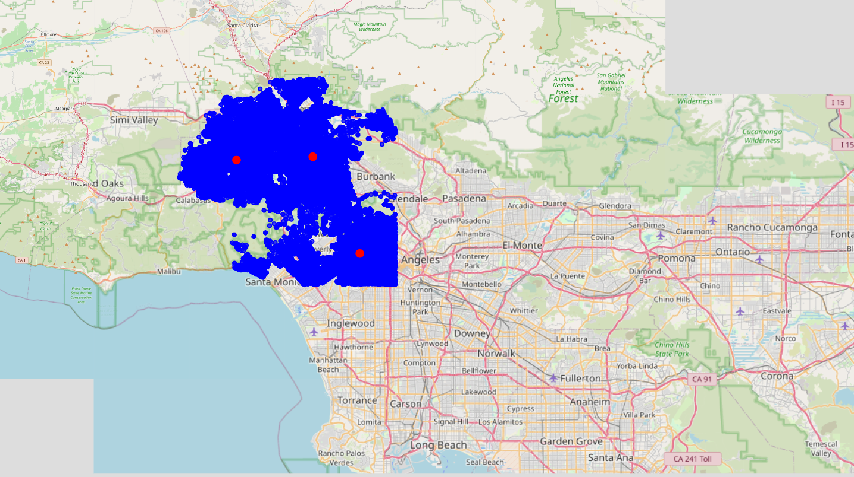

Slide 18
SMART Q2: How accurately can we predict the likelihood of crime being solved in Los Angeles based on the available data features in 2023?
The features that effect chances of crime being solved are Area, Vict age, crime type(crm cd), Weapon Used, Month.
The Dependent variable is “Status”.

Slide 19
logistic Regression
Decision Tree
K-NN
Random Forest
Models used:

Slide 20
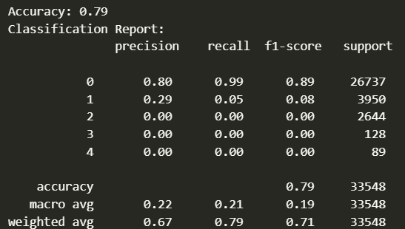
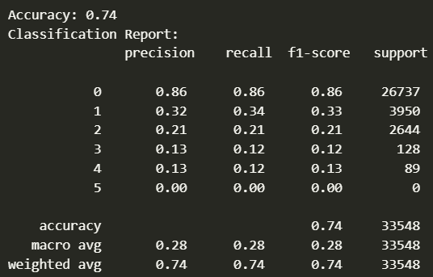
Logistic Regression :
Decision-Tree

Slide 21
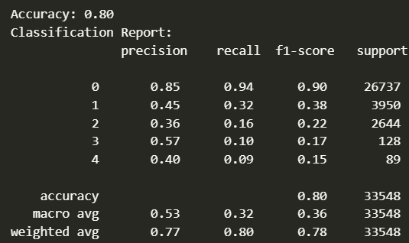
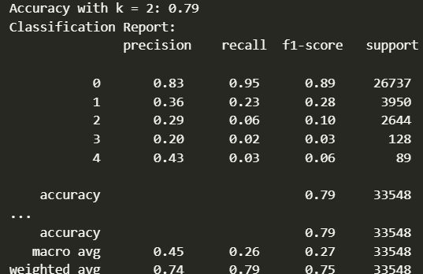
Random-Forest
K-NN

Slide 22
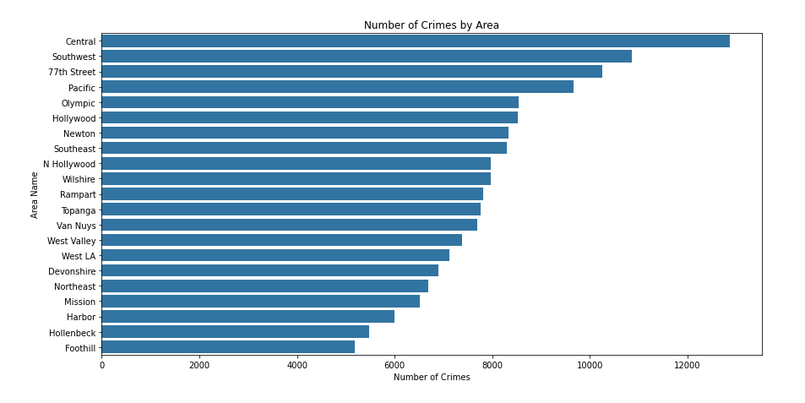
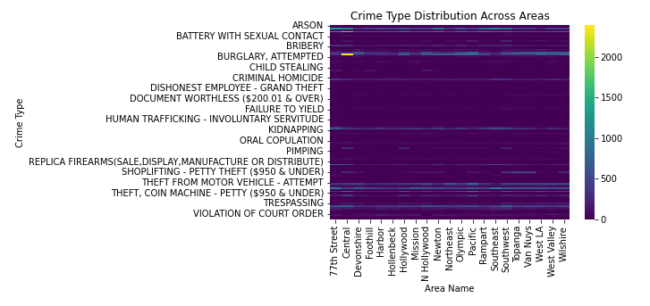
SMART Q3: What are the key factors influencing crime rates across the neighborhood?
Notes:
Crime Type Distribution Across Areas: The heatmap shows how different crime types are distributed across various areas. This can help in identifying if certain crimes are more concentrated in specific regions.

Slide 23
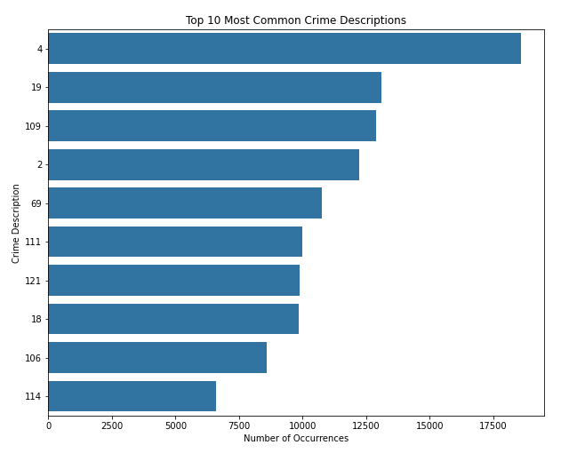
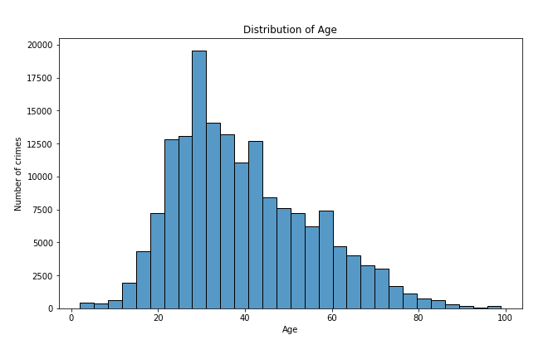
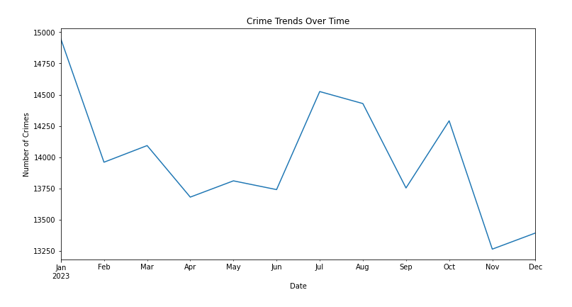
Notes:
Crime Distribution by Area: The bar chart shows the frequency of crimes in different areas. This visualization clearly identifies which areas have higher crime rates and may require further investigation into what makes them more prone to crime.
Crime Trends Over Time: The line chart plots the number of crimes per month, giving insights into how crime rates fluctuate throughout the year. It can be helpful to examine these trends in relation to specific events or changes in policy.
Distribution of Victim Age: The histogram provides an overview of the age distribution of crime victims. This could be cross-referenced with the type of crimes to find age-related trends.
Top Crime Types: The list of top crime types gives an idea of the most common crimes, which is useful for prioritizing resources and prevention efforts.

Slide 24



Chi-Square Test for Independence: To test if there's a significant relationship between two categorical variables (e.g., AREA NAME and Status).
ANOVA Test: To compare the means of a continuous variable across multiple categories (e.g., Vict Age across different AREA NAME).
Correlation Test: To measure the strength of the association between two continuous variables (e.g., TIME OCC and Vict Age).
Based on these results, we have evidence to consider these variables as potentially important features in our predictive models.
Notes:
Confirm Relationships: Validate whether the relationships we observe in the EDA are statistically significant.
Feature Selection: Identify which features have a significant relationship with our target variable and should be included in our models.
Chi-Square Test:
Chi-Square Statistic: 4097.73 suggests a very strong relationship.
P-value: Essentially 0 (even after attempting to show more decimal places), indicating that the relationship between the area and the status of the crime is statistically significant.
ANOVA Test:
F-statistic: 85.39 is relatively high, indicating a strong between-group variance compared to within-group variance.
P-value: Approximately 1.07*10^−37, which is virtually zero, shows that there are statistically significant differences in victim age among the different areas.
Pearson Correlation Test:
Coefficient: -0.012 suggests a very small negative correlation between the time of the occurrence and the victim's age, which is probably not practically significant.
P-value: Approximately 6.78*10^−7, indicates that the small correlation is statistically significant, but given the size of the dataset, small correlations can become statistically significant even when they might not be meaningful in a practical sense.

Slide 25
Predictive Models
Random Forest
Gradient Boost
XGBoost
CatBoost
categorical_features = ['AREA NAME', 'Crm Cd Desc', 'Premis
Desc', 'Weapon Desc', 'Day_of_Week']
Notes:
These chosen models offer a balanced approach, combining performance, flexibility, and interpretability. They are suitable for exploring complex relationships and handling the challenges presented by our dataset.
features = ['TIME OCC', 'AREA', 'Crm Cd', 'Vict Age', 'Weapon Used Cd']
target = 'Status'
Decision Trees: Although simple and interpretable, decision trees can easily overfit and lack robustness compared to ensemble models.
Logistic Regression: While useful for simpler binary classification tasks, it may struggle with complex patterns and imbalanced datasets.
Support Vector Machines (SVM): too long

Slide 26
All models achieved a similar accuracy of approximately 81%, indicating robustness in predicting crime status based on the available data
Models like Random Forest and XGBoost provided insights into feature importance, revealing that factors such as time of occurrence, area, and crime type were significant predictors of crime outcomes.
Notes:
Stronger performance in handling class imbalance and providing clearer feature importance metrics as side from accuracy score.
Key Findings:
Influence of Area on Crime Rates:
The visualizations revealed significant variation in crime rates across different areas. Areas like Central and Hollywood showed higher crime instances, potentially indicating socio-economic factors or population density effects.
Chi-square tests confirmed a significant association between the area and crime type, suggesting that certain areas are predisposed to specific types of crime.
Temporal Influences:
Seasonal and Time Factors: Time-based data analysis highlighted trends such as increased crime rates during specific months or times of day.
Socio-economic and Demographic Factors:
Victim Age and Crime Type Correlation: Statistical analysis showed significant differences in victim age across different crime types, indicating demographic targeting in certain crimes.
The key factors influencing crime rates in LA:
Geographic Area: Different neighborhoods exhibit distinct crime patterns.
Time of Crime: Specific times of day and certain months or seasons see higher crime rates.
Type of Crime: Variations in crime types across areas indicate different local conditions.
Victim Demographics: Age of victims varies with different types of crimes, suggesting targeting or vulnerability of specific groups.

Slide 27
Conclusion
Chances of a crime being solved.
Spot where and when crime trends to happen.
Geographic Area, Time of Crime, Type of Crime, Demographic
This knowledge helps the authority to come up with strategies
and policies.
Notes:
From our analysis, we were able to find the chances of a crime being solve, we can look for ways to increase the chance for all crimes.
We can pretty much spot where and when crime trends to happen. Along with the key factors that affect the likelihood of a crime occuring which are
geographic are, time, type, demographic or victim age
These findings can help the authority to come up with strategies and policies that can reduce the crime in the neighborhood or even prevent crimes.

